Slide 1
Graphene
Team
Adith Tekur
(System Architect/Tester)
Neha Rastogi
(System Integrator)
Pooja Prakash
(Language Guru)
Sarah Panda
(Project Manager)
Sumiran Shah
(System Architect/Tester)
So what’s the most efficient way to spam all your Facebook friends?

Slide 2
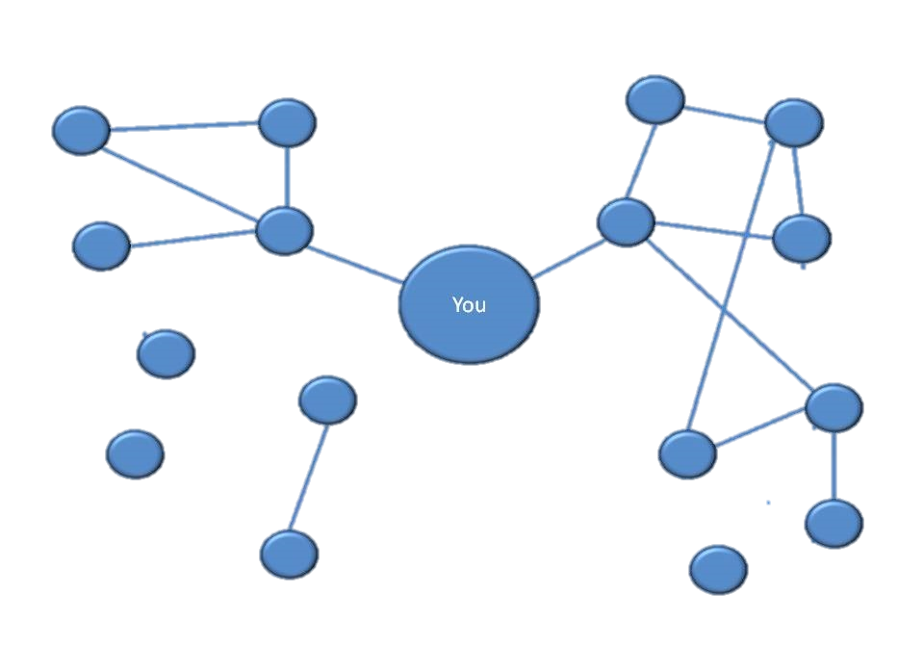
graphene> why();
Web 2.0. Cloud. Big Data. Social Networking.
Need to analyze common patterns, find trends
Useful for advertisers, market researchers, beginner programmers who just need another language with easy to use graph interfaces

Slide 3
graphene> what();
Graphene is:
Dynamically typed
Interpreted
Concise
High level
Graphene enables users to perform common and complex graph manipulations on user defined or imported data
Graphene features a powerful visualization library to display graphs or input them manually
Graphene can be invoked in a REPL to perform quick, incremental operations

Slide 4
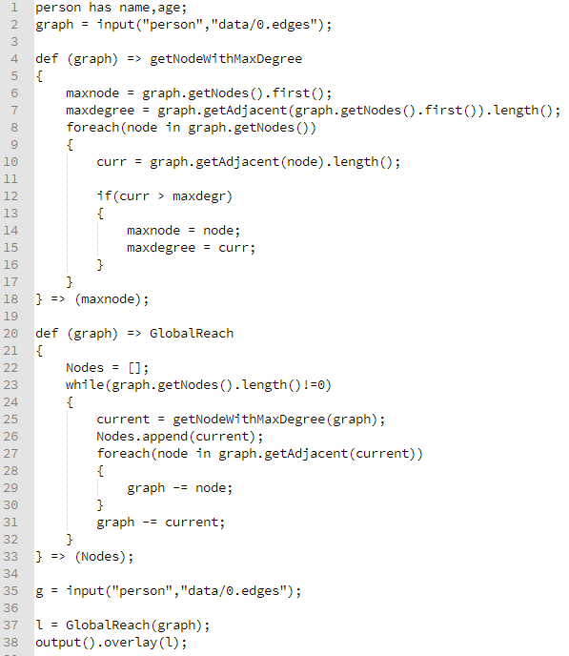
graphene> sample();
Define a type of node of type person and read file dump
User function to find the node with max degree from a graph
Return maxnode variable
List type
Node removal operator
Visualize!

Slide 5
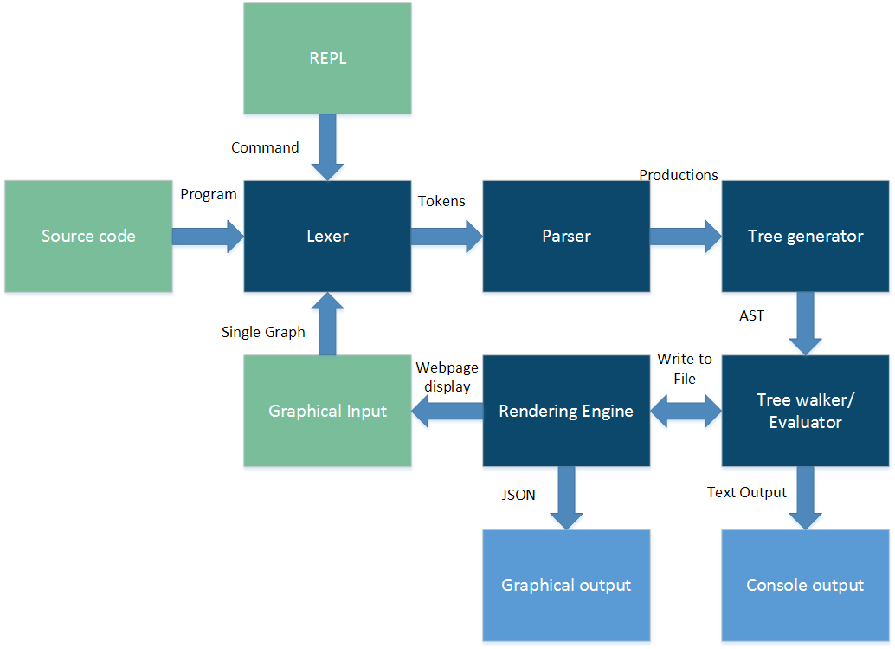
graphene> how();
Flow diagram

Slide 6
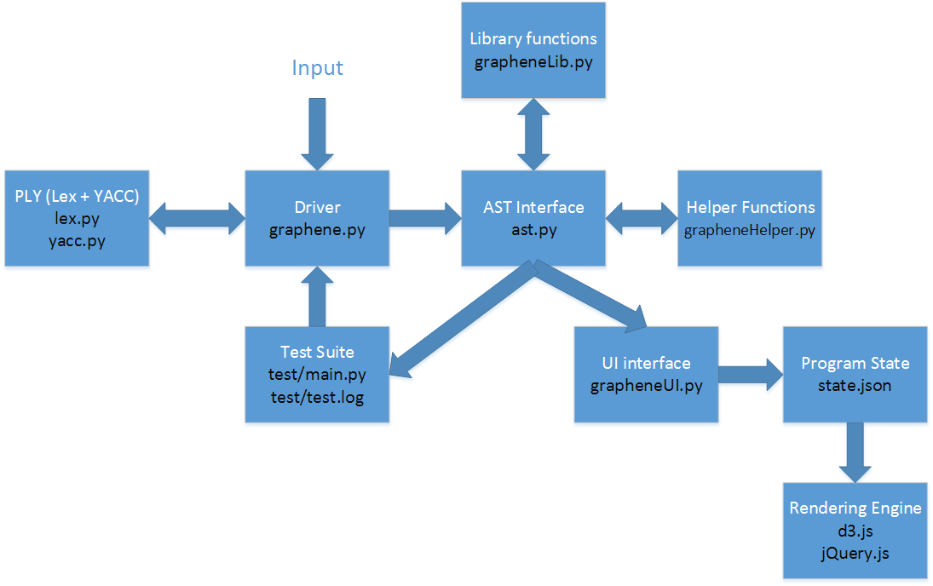
graphene> how();
Compiler and supporting architecture

Slide 7
graphene> write();
No main function. Script is executed line by line
Dynamically typed data
Specialized Graph and Node data types and operations
Features basic constructs such as if, for, foreach, while, functions
More advanced constructs such as multiple return arguments, lambdas(first class functions), inbuilt libraries for clustering nodes, graph manipulation operators

Slide 8
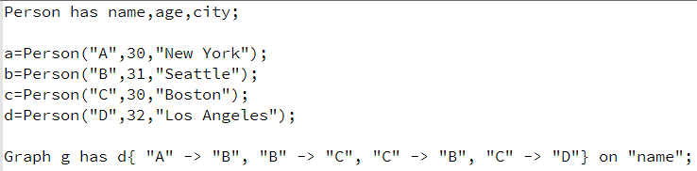
graphene> write();
Getting your graph ready:
Define a node type
Create nodes
Define a graph with edges

Slide 9


graphene> write();
Or maybe import from file
Or create a mesh and use edge/node operators

Slide 10
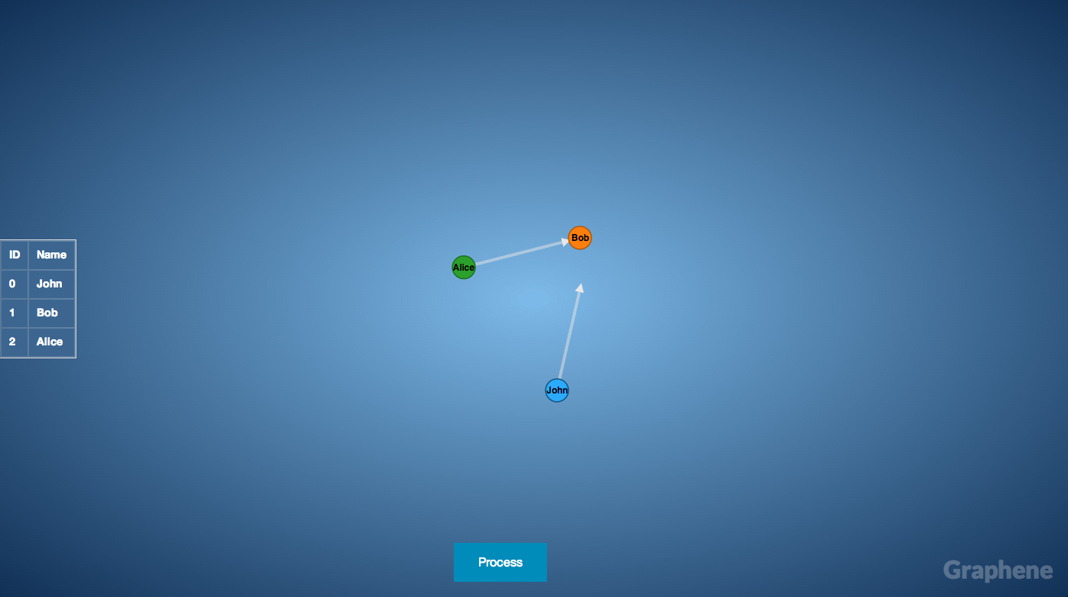
graphene> write();
Or, just ask the user nicely to do it for you

Slide 11
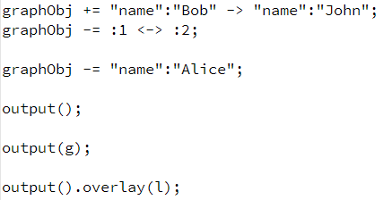
graphene> write();
Add edges by lookup, by id
Removing nodes
Display the program state
Display a particular graph
Overlay the output with a nodes in a particular list of nodes as highlighted

Slide 12
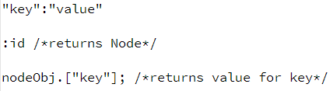
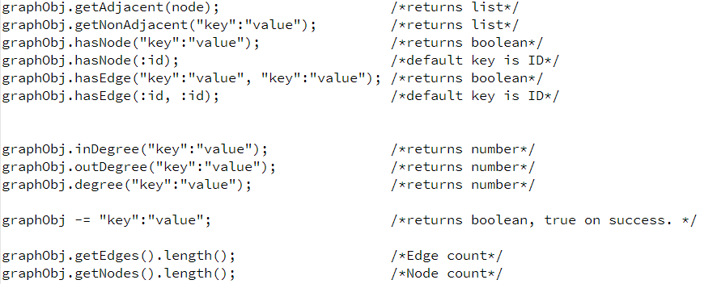
graphene> write();
Node and Edge operations

Slide 13
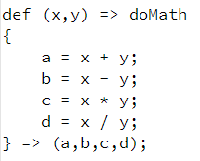
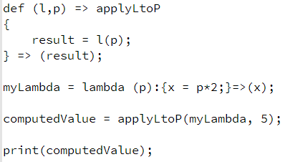
graphene> write();
User defined functions
Lambdas

Slide 14
graphene> demo();

Slide 15


graphene> develop();
v/s

Slide 16


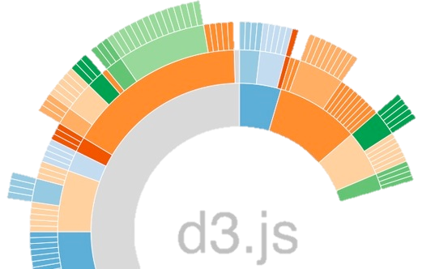



graphene> cross_platform();

Slide 17
graphene> run();
Bash Script to call the compiler in different modes
Modes include debugging mode, regression testing mode.
Run with default arguments
Run with debugging information
Run with a file input
Run the help manual

Slide 18
graphene> run();
Run the test with default arguments
Run the tests independently
Run test number 23

Slide 19
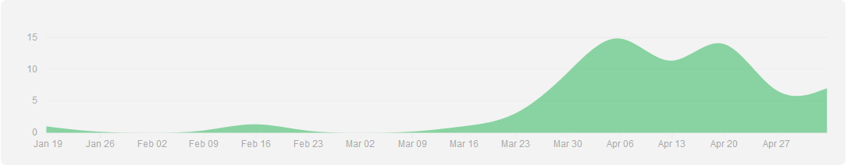
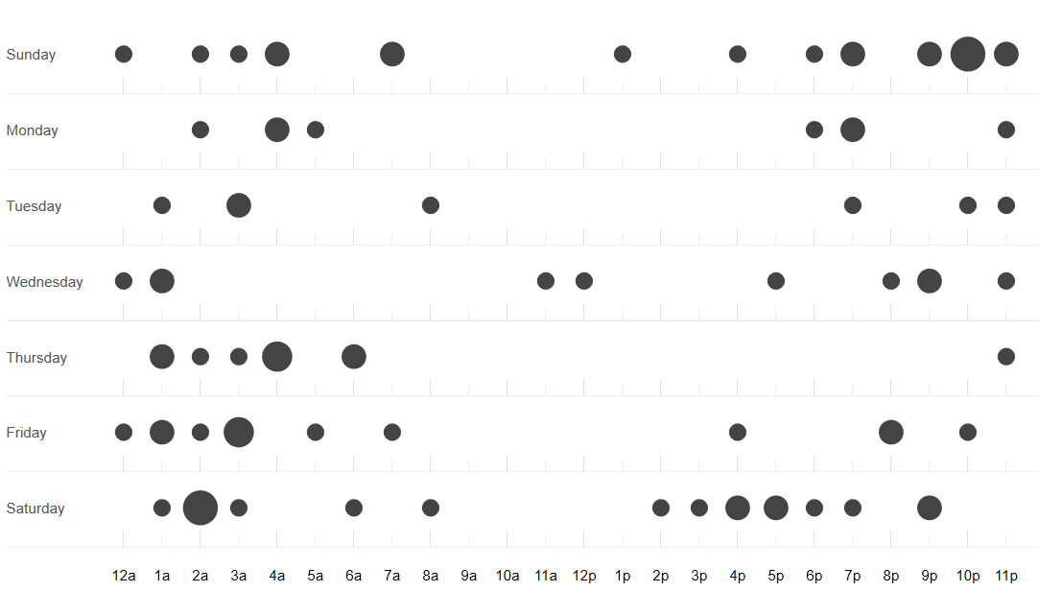
graphene> manage();

Slide 20
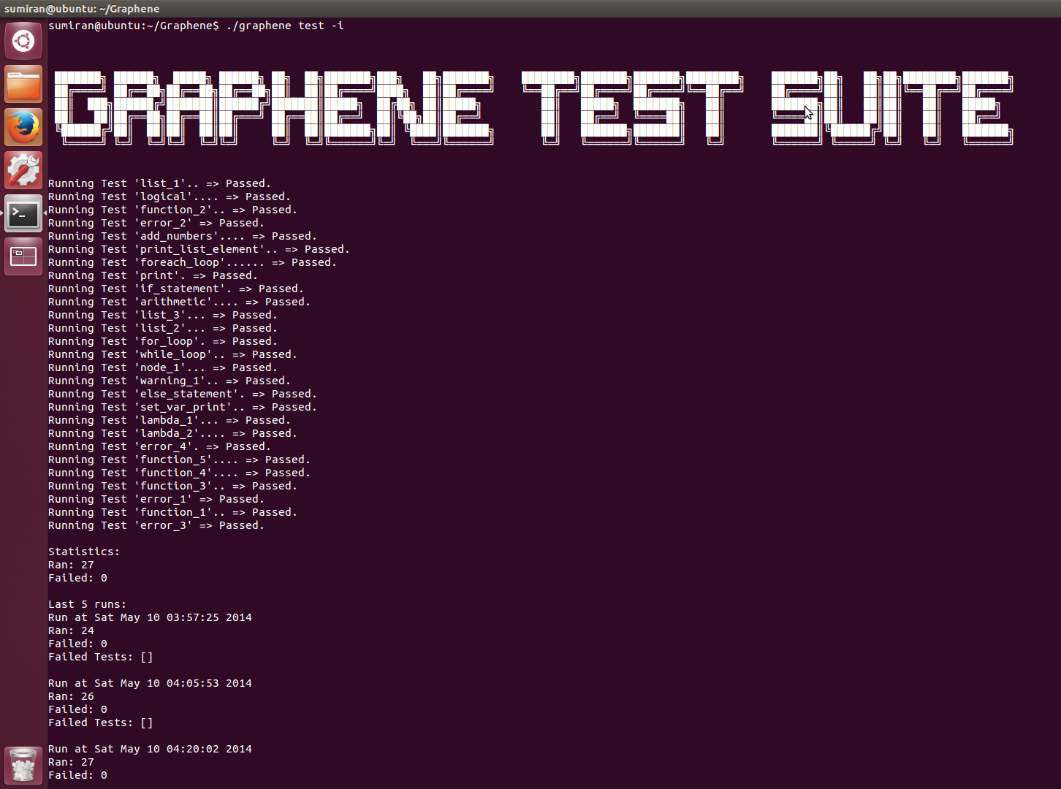
graphene> test();

Slide 21
graphene> test();
Testing framework included tests which consists of the test code and expected output.
Extensive tests to check all the basic as well as new constructs.
Basic constructs include arithmetic, logical, control flow, lists, functions, error handling
New constructs include lamda functions, node property, clustering.

Slide 22
graphene> exit();
What worked:
Impeccable rigor in design,implementation and testing standards
Learning to be proficient at git and using it as more than a dumb remote disk
What we could have improved
Better definition of scope early on
Better prioritization of feature implementations
For more details:
https://github.com/Adith/Graphene

Slide 23
